Slide 1

Future Space
An analysis of Stellaris Players’ Custom Created Playthroughs
Bogdan Borcos
Last updated 7th of July 2025

Slide 2

Table of Contents
Brief introduction of the subject
Purpose of Analysis
Description of the Data
Process and tools used
Findings
Conclusion & Recommendations
Bibliography

Slide 3
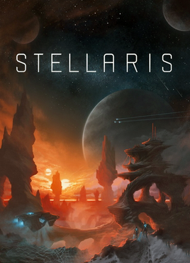
What is Stellaris?
Stellaris is a strategy video game developed by Paradox Development Studio and published by Paradox Interactive
The game gives the player control over a space faring civilization as it progresses through the stars and interacts with phenomena, celestial objects and other civilizations
Stellaris box/cover art

Slide 4
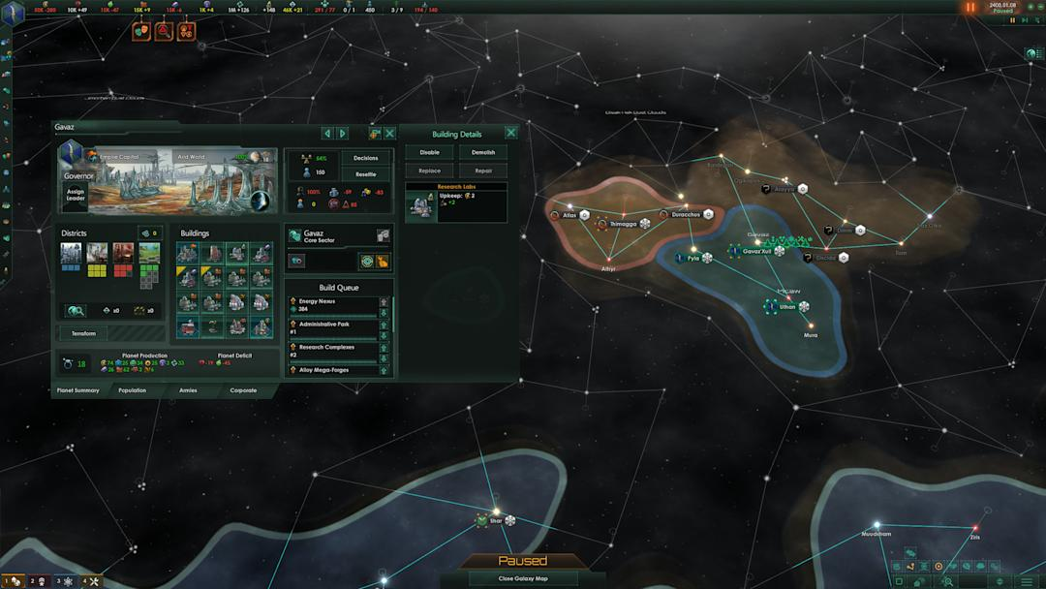
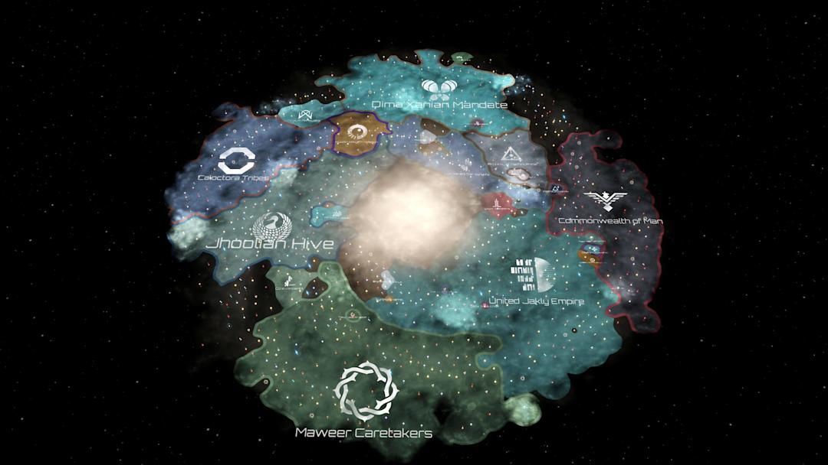
Why Stellaris?
One of the game’s core features is allowing the player to create and customize their own civilization, from appearance to origin to internal politics, tailored to their preferred playstyle
The customization choices provide glimpses into the players’ interests, which when analyzed, can provide insight for future game and business development
Official Stellaris screenshots from the studio’s website

Slide 5
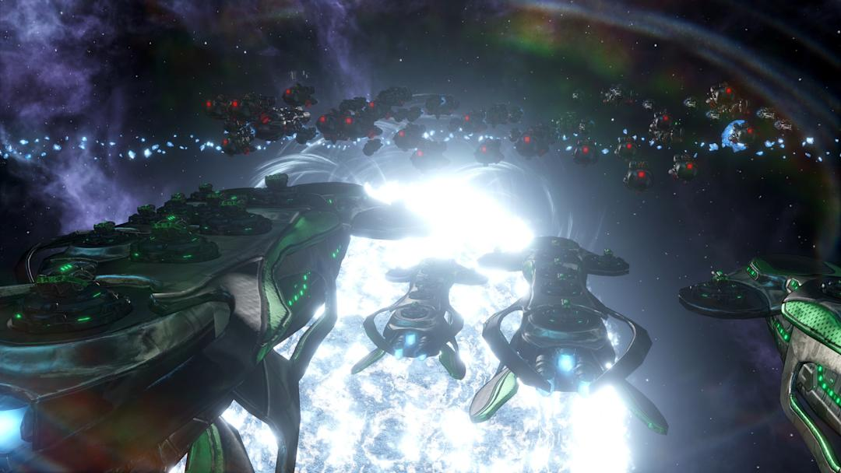
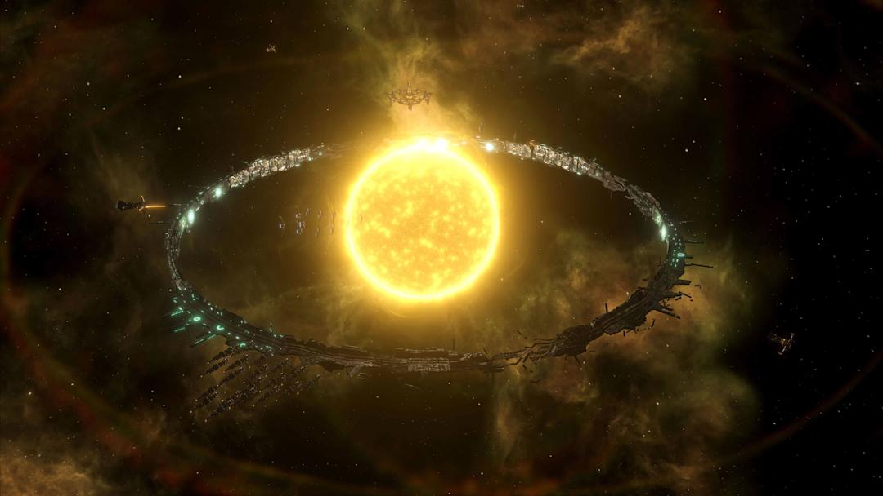
The Question? The Future
Where does the game go from here?
What are some aspects of the game which need updates?
What features could still be added to the game?
Official Stellaris screenshots from the studio’s website

Slide 6
The Data
Manually collected the in-game data on player created civilizations and listed them in a spreadsheet file
Totalled number of custom civilizations collected was 122
Custom civilization data included player choices for internal management (Ethics, Government Types, etc) and for civilization background (Origin, Home Planet etc)
Included data for inspiration source on each civilization

Slide 7
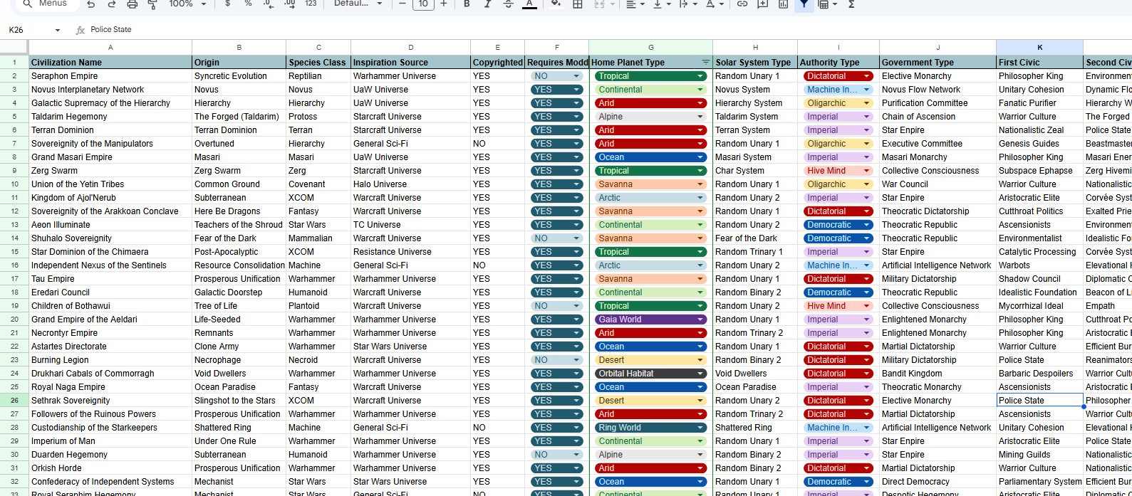
Snapshot into the Data

Slide 8
Data Cleaning & Processing
Utilized Spellcheck and Filters to check for any typos and inconsistencies in the data
Implemented data validation techniques (dropdowns) where possible
Made use of VLOOKUP to clarify and structure the data
Applied IF formulas for separating Copyright and Non-Copyright inspiration sources

Slide 9
The Analysis
Made use of JOINS, SORT and TRANSPOSE to clarify the data for Ethics and Civic choices (which were originally a separate column for each choice)
Another special case was the separation of Fanatical (which focus two points on one particular ethic), Gestalts (which do not use ethics) and Balanced (which spread out their ethic points) Civilizations.
Used Pivots to restructure the data and allow generation of graphs and visualize data

Slide 10

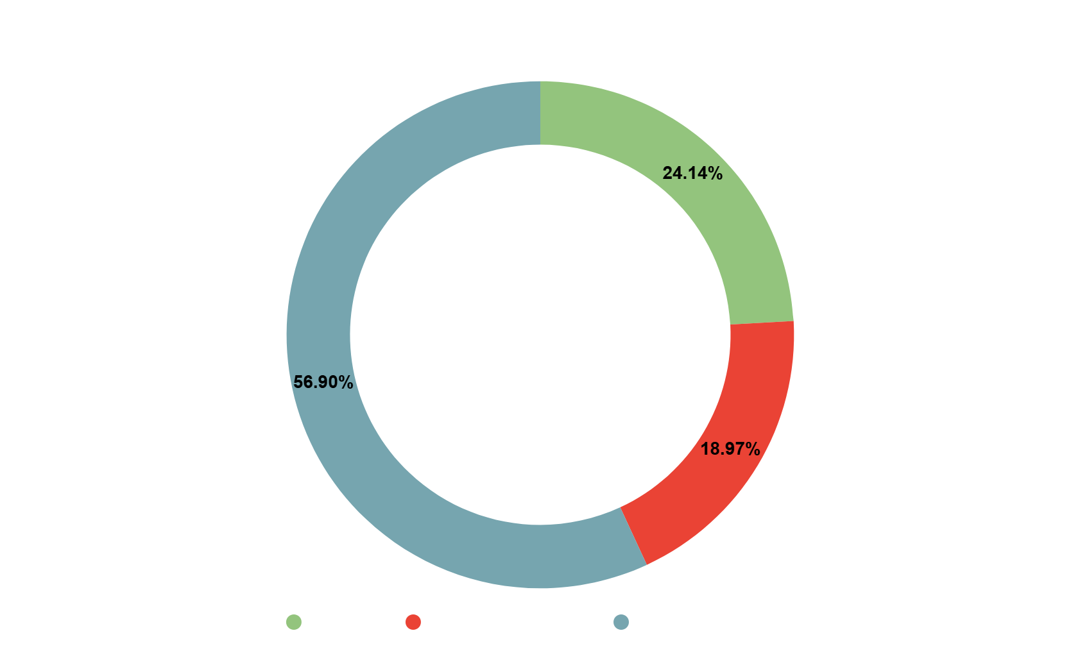
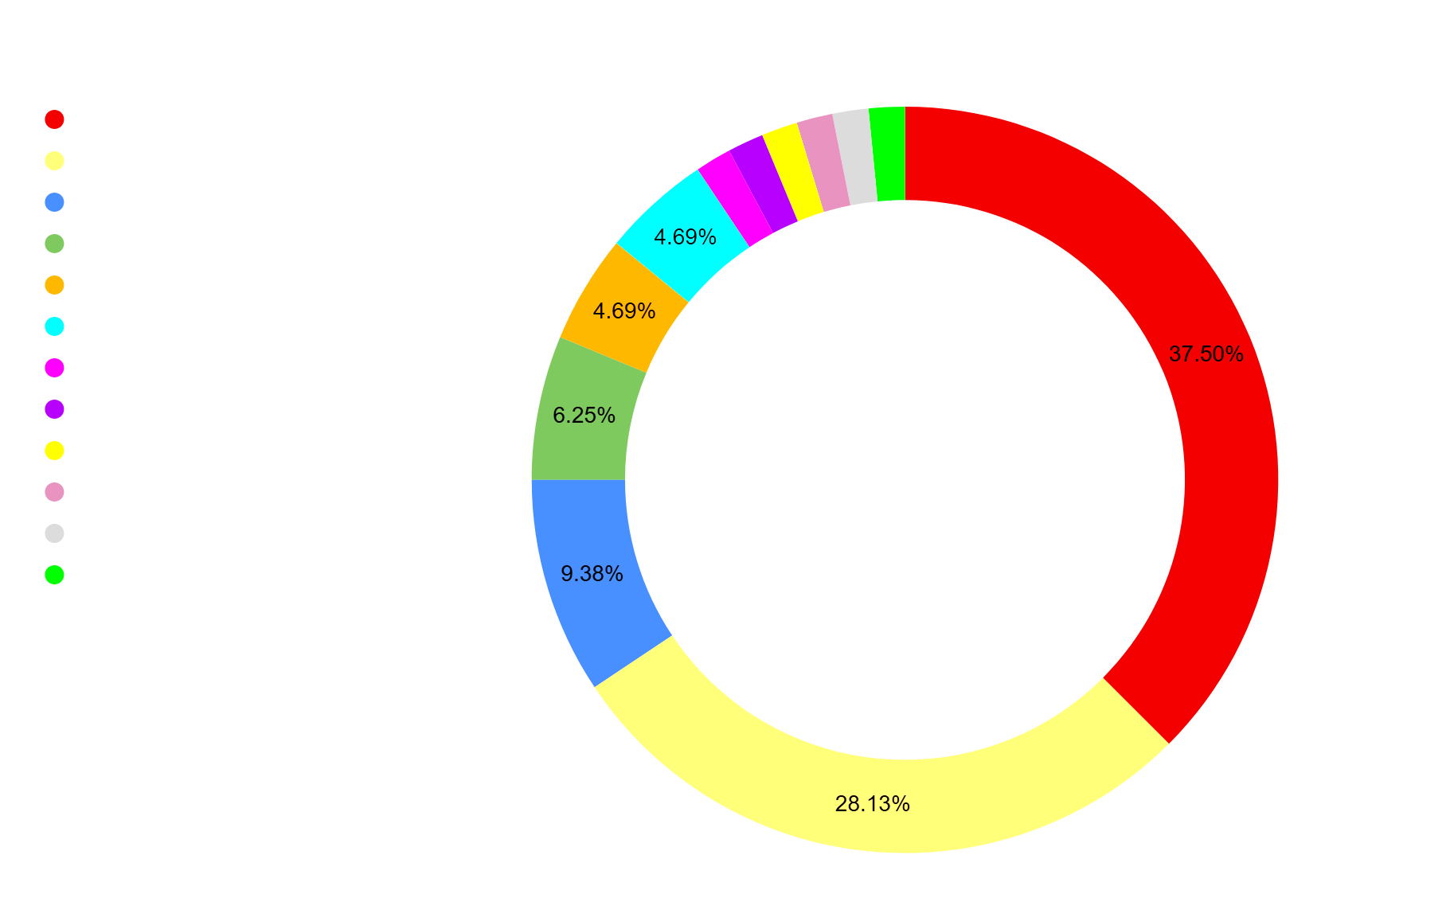
Where ideas come from
Non-Copyright sources are dominated by general Sci-Fi pop culture
Copyright sources are much more diverse but still show a tendency towards widely popular gaming franchises

Slide 11

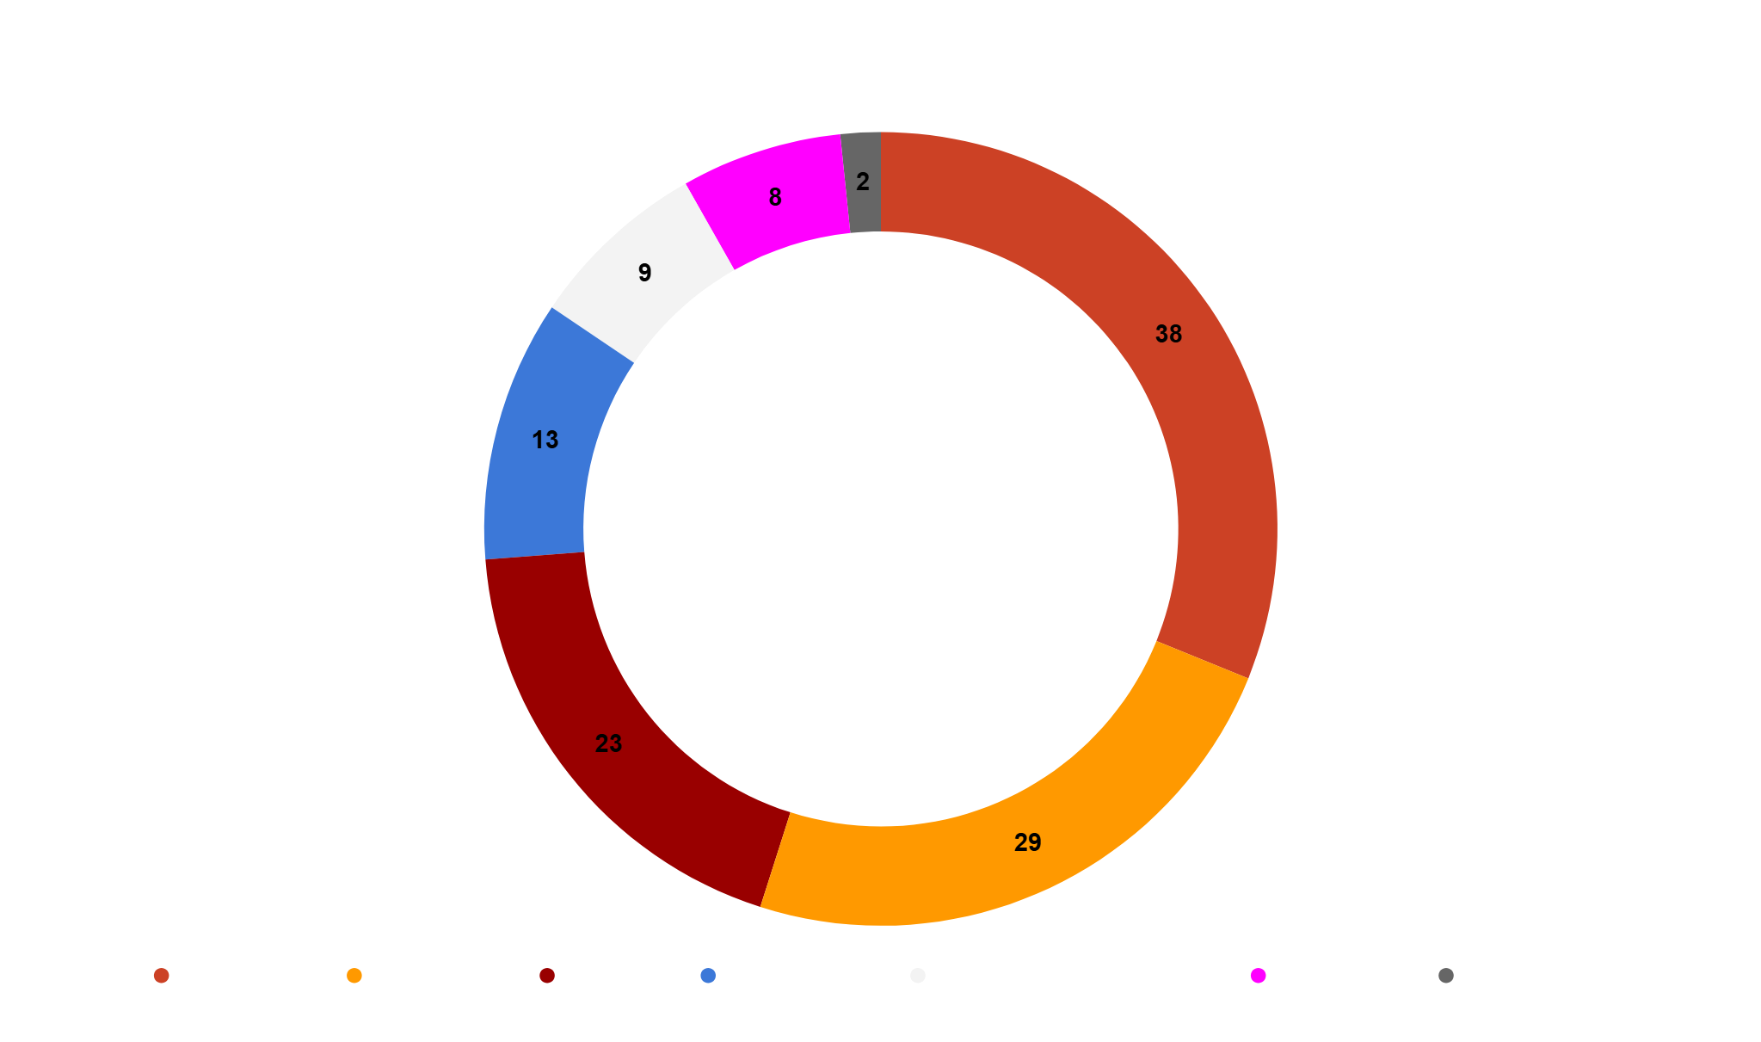
How the Galaxy Looks Like
Out the total number of civilizations there is a clear leaning towards the more Authoritarian side
The chart is color coded from warmest color to coldest based on Authoritarian level

Slide 12
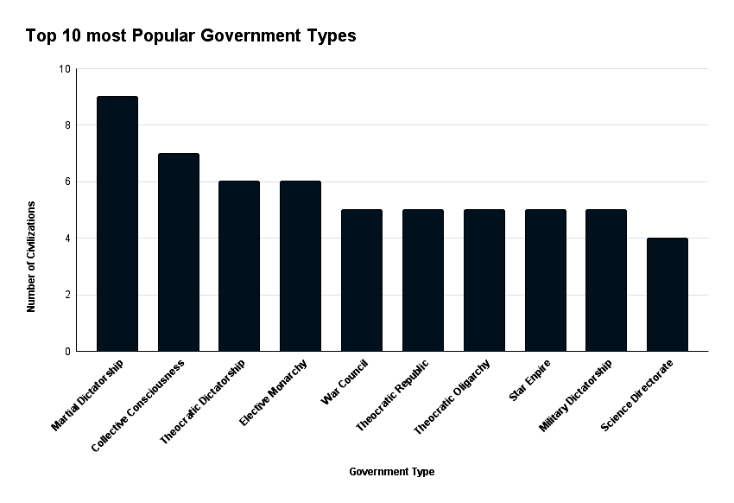
How the Galaxy Looks Like
A quick view of the most popular Government types shows that Authoritarian style gameplay is preferred

Slide 13
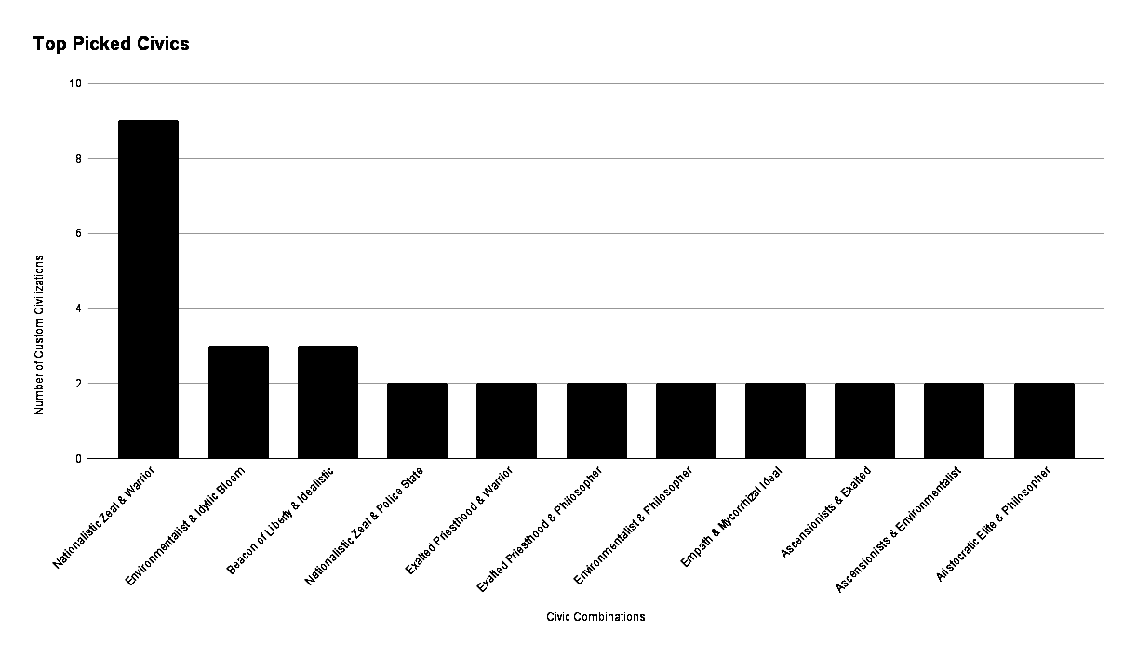
How the Galaxy Looks Like
Most picked Civics show a trend towards more aggressive gameplay

Slide 14

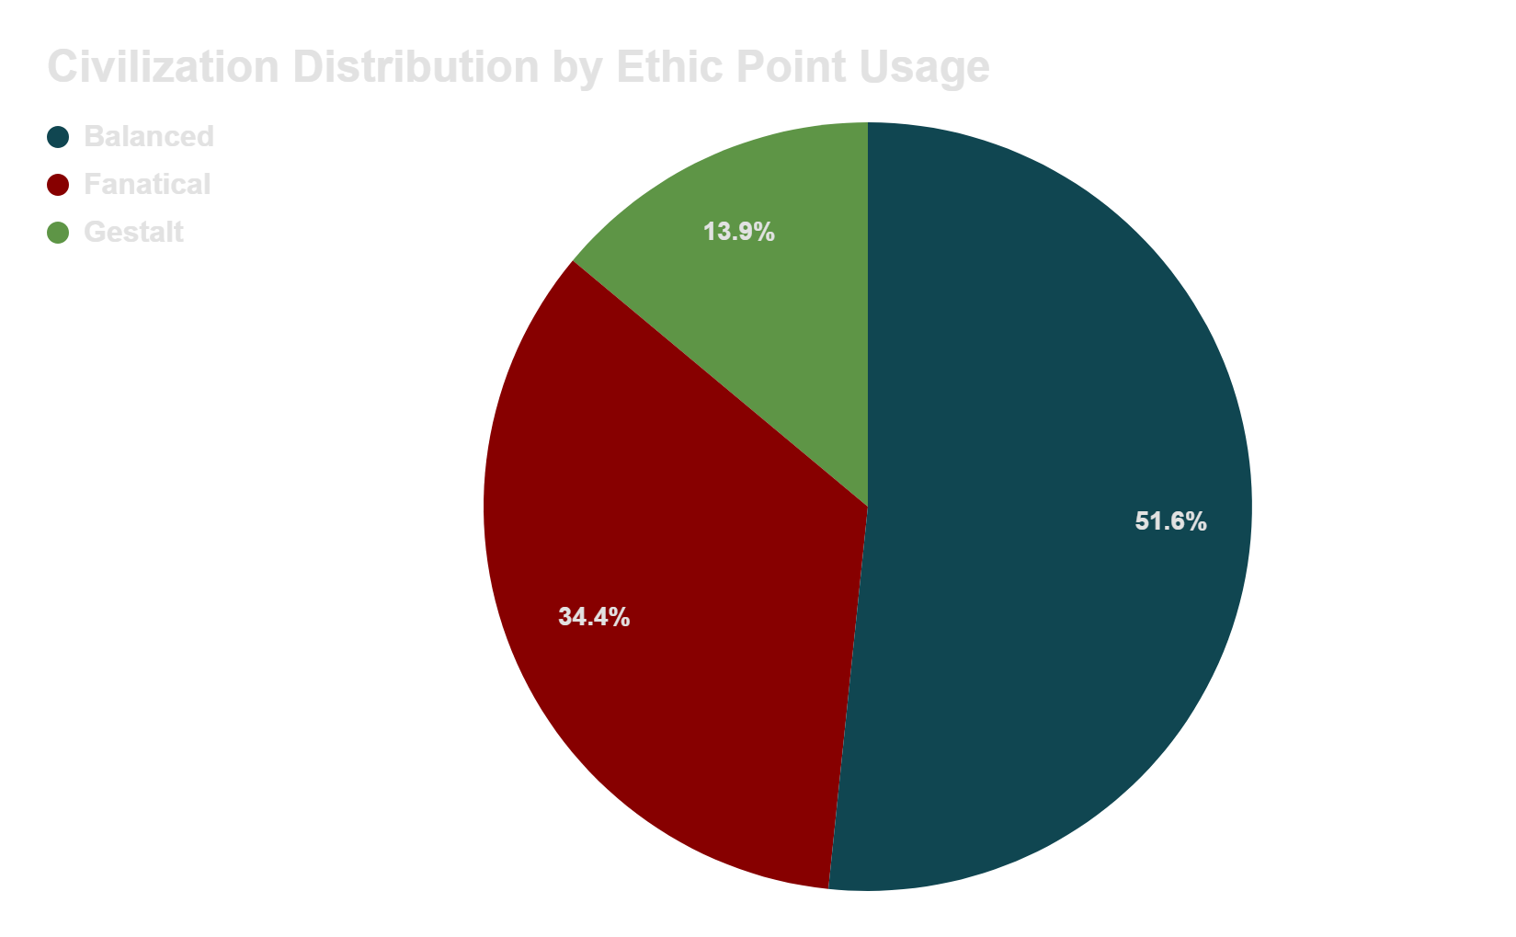
Ethics in Space
Ethics in-game come to define the playstyle of the player
Separating them by how the player spends their Ethic points, there is a leaning towards a more “Balanced” approach
This “Balanced” approach shows that players prefer combining Ethics and avoid “pigeon-holing”

Slide 15
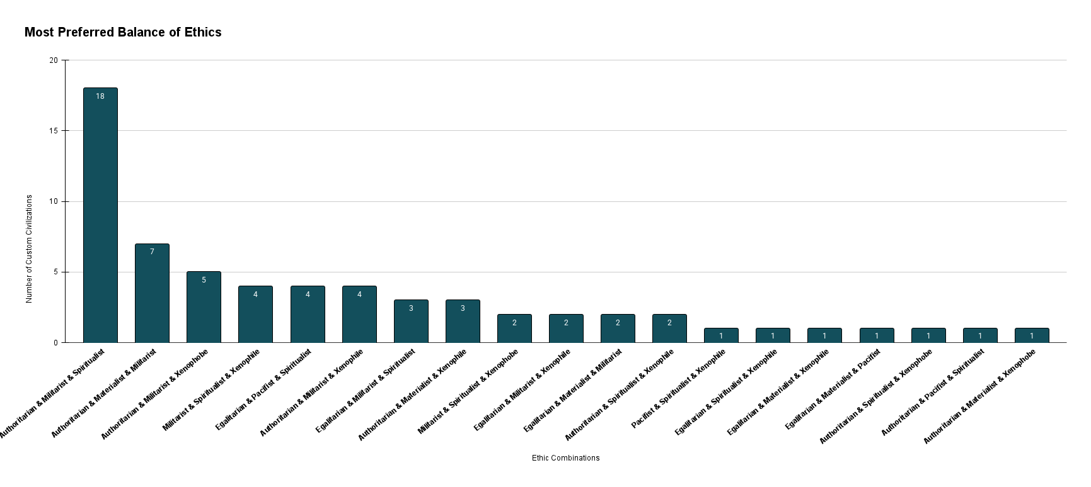
Ethics in Space
A deeper look into the most common combinations of Ethics shows that the Authoritarian and Militarist Ethics are present in most player made combinations

Slide 16
Gleamed Knowledge
Players seem to be heavily inspired from popular Sci-Fi franchises and Sci-Fi themes in general. Would recommend continuing to implement “Easter Eggs” from these sources to promote player engagement.
Players seem to favor the Authoritarian ethic, showing a tendency to avoid the internal politics mechanic. Would recommend further analysis on player gameplay.
The Militaristic ethic seems to be favoured in “Balanced” combinations. Would recommend further analysis into player gameplay.
A possible future DLC for the game, targeting internal governing systems in general or democratic systems in particular, would cover a currently underplayed playstyle.
Additionally, a DLC focused on combat and warfare would be well received and possibly very profitable as most players seem to engage in this playstyle.

Slide 17
Credit where credit is due
Paradox Development Studio - Producer of the video-game Stellaris
Paradox Interactive - publisher of the video-game Stellaris
pixabay(dot)com - source of the stock images used in the presentation
Google - for Sheets, Slides, Drive and Docs which were used in the making of this presentation and analysis

